Slide 1

Your First Investment Property or Second Home
How to Buy Smart, Finance It Right, and Start Building Wealth Through Real Estate
Featuring David Starling | NMLS# 119565 | Hosted by Scotty Hudspeth

Slide 2

Welcome
"Today we're talking about buying an investment property or second home. Maybe you've thought about rental income, building wealth, or owning a place at the beach or in the mountains — but most people have one big problem: they have no idea where to start."
Whether you've been dreaming about a vacation getaway or your first income-producing property, this conversation is designed to cut through the noise and give you a clear, honest picture of what's possible. David Starling has helped countless buyers navigate exactly this journey — and it starts with one simple question: what are you trying to do?
DAVID STARLING | NMLS# 119565

Slide 3

Investment Property or Second Home?
These two property types might seem similar, but they come with distinct financing rules, occupancy requirements, and strategic purposes. Understanding the difference is the very first step.
🏖️ Second Home
🏘️ Investment Property
Primarily for personal use and enjoyment
Often located in a vacation or highly desirable destination
Occupied by the owner for a meaningful portion of the year
Must meet applicable occupancy and program requirements
Purchased primarily to generate income or build long-term wealth
May be rented to tenants on a short- or long-term basis
Can produce monthly cash flow when structured properly
Financing requirements and guidelines can differ significantly
The first conversation isn't just about rates — it's about what you're trying to do with the property.
DAVID STARLING | NMLS# 119565

Slide 4





You May Be Closer Than You Think
One of the most common assumptions is that you need a massive pile of cash sitting in the bank before you can even consider buying. That's not always the case. There are more pathways to getting started than most people realize.
Savings & Eligible Assets
Equity Strategies
Your existing savings and qualifying assets may cover more than you expect when paired with the right loan program.
Equity you've already built in your primary home may be worth exploring as a source of funds for your next purchase.
Gift Funds
Build the Right Plan
When permitted by the loan program, gift funds from eligible sources can contribute to your down payment or closing costs.
Sometimes it's about strategy — selling an asset, timing the market, or simply mapping out a 6–12 month runway to get there.
Don't disqualify yourself before talking to someone who actually understands the financing options available to you.
DAVID STARLING | NMLS# 119565

Slide 5
The 4 Numbers You Need to Know
If you're thinking about your first investment property, the conversation doesn't have to be overwhelming. David focuses on four core numbers that paint the complete financial picture — and give you a clear foundation to make a smart decision.
1
2
Purchase Price
Cash Needed
What does the property actually cost? This sets the baseline for everything else.
Down payment, closing costs, and reserves — how much do you need to bring to the table?
3
4
Monthly Payment
Potential Rental Income
Principal, interest, taxes, and insurance — what does the full monthly obligation look like?
What could the property realistically generate in rent, and how does that affect the picture?
"We can make this complicated, or we can start with four numbers." — Scotty Hudspeth
DAVID STARLING | NMLS# 119565

Slide 6
Cash Flow Is Not Just Rent Minus Payment
It's one of the most common misconceptions in real estate investing: "The rent is $2,500 and my mortgage is $2,000 — I'm making $500 a month!" Not quite. True cash flow accounting means looking at the full picture of what owning the property actually costs.
What Most People Count
What You Also Need to Include
Rent collected minus the mortgage payment. That's it. It feels simple — and it feels profitable.
But this approach consistently leads investors to overestimate returns and get caught off guard by real-world expenses.
Property taxes and homeowner's insurance
HOA dues (if applicable)
Repairs and routine maintenance
Property management fees
Vacancy allowance
Utilities when owner-paid
Capital improvements and reserve fund contributions
The goal isn't to talk yourself into a property. It's to look at the real numbers — and make a decision based on reality.
DAVID STARLING | NMLS# 119565

Slide 7
What Makes a Good First Investment Property?
Your first investment property doesn't need to be a grand slam. The goal is to get on base — buy something solid, learn the process, and build from there. Here's what to evaluate before you fall in love with any particular deal.
📍 Location
📈 Rental Demand
🔧 Property Condition
💰 Realistic Income
Strong neighborhoods with low vacancy and stable demand hold value over time.
Is there consistent demand for rentals in this market? Research before you commit.
Understand what you're buying — deferred maintenance can quickly erode your returns.
Use actual comparable rents, not best-case scenarios, when building your numbers.
🏷️ Taxes & Insurance
🔄 Resale Potential
These vary significantly by location and property type — always factor them in.
Think beyond today. A good investment property should also hold long-term resale value.
DAVID STARLING | NMLS# 119565

Slide 8



The Second Home Conversation
For many buyers, the dream of a beach house, a mountain cabin, or a lakeside retreat is deeply personal. But turning that dream into a smart financial decision requires a clear-eyed look at the details — before you start touring properties.
Intended Use & Occupancy
Affordability & Down Payment
Short-Term Rental Plans
Thinking about renting it on Airbnb or VRBO when you're not there? This conversation needs to happen before you buy — it can impact your loan type, insurance, and financing options.
How you plan to use the property directly affects what loan programs are available. Occupancy requirements must be met and should be clearly understood before financing.
A second home adds to your existing financial obligations. Model the full monthly cost — not just the mortgage — against your budget to confirm it's sustainable.
The way you plan to use the property matters — both for your lifestyle and your loan.
DAVID STARLING | NMLS# 119565

Slide 9

Can Rental Income Help You Qualify?
This is one of the questions David hears most often — and the honest answer is: it depends. Rental income can sometimes be used to help qualify for a loan, but the rules vary based on the property type, the loan program, and your specific financial situation.
Existing Lease Agreements
Market Rent Documentation
A signed lease with a qualified tenant may allow the documented rent to be factored into your qualifying income, depending on program guidelines.
In some cases, a market rent analysis or appraisal rent schedule can be used even if the property is not yet tenanted.
Tax Return History
Program-Specific Guidelines
If you've owned rental properties before, your tax returns may show rental income history that can be used in qualifying calculations.
Each loan program handles rental income differently. This is exactly why having a detailed conversation with your lender first is so important.
"Every situation is different. This is why you have the conversation first." — Scotty Hudspeth
DAVID STARLING | NMLS# 119565

Slide 10
What If the Property Could Help You Qualify?
There's a loan product many first-time investors have never heard of — and it could change the conversation entirely.
What Is a DSCR Loan?
Why It Matters
DSCR stands for Debt Service Coverage Ratio. Certain investment property loan programs are designed to qualify borrowers based primarily on the property's rental cash flow — rather than traditional personal income documentation like W-2s or tax returns.
In simple terms: instead of asking only how much you make, the lender looks at what the property may produce.
For buyers who are self-employed, have complex income structures, or are building a real estate portfolio, DSCR loans can open doors that traditional financing might not.
It's not a shortcut — credit, down payment, reserves, property type, and rental analysis all still matter. But it's a powerful option worth knowing about.
Ask David if a DSCR loan could be the right fit for your situation.
DAVID STARLING | NMLS# 119565

Slide 11





DSCR: Why Investors Ask About It
Once investors learn about DSCR loans, they often wonder why no one told them sooner. Here's a closer look at how these programs work and who they're designed for.
Designed for Investment Properties
Rental Cash Flow is Key
DSCR programs are specifically built for non-owner-occupied investment properties — not primary residences or second homes.
The property's rental income potential plays a central role in the qualifying analysis — reducing the emphasis on your personal income documentation.
Useful for Self-Employed Borrowers
Other Factors Still Apply
Real estate investors and self-employed buyers who have strong assets but complex income may find DSCR a more flexible path forward.
Credit score, down payment, reserves, property type, and rental analysis all remain important qualifying factors under DSCR programs.
Guidelines and availability vary by lender and program — this is why talking to David before assuming you can't qualify is so important.
DAVID STARLING | NMLS# 119565

Slide 12

Your First Property Doesn't Need to Be Perfect
Perfectionism is one of the most expensive habits in real estate. Buyers who wait for the perfect deal, the perfect rate, the perfect market, and the perfect property often end up waiting for years — while others are already building equity and cash flow.
Buy Based on Your Financial Goals
Run Realistic Numbers
The right property is the one that fits your actual numbers and your actual timeline — not the one that looks best on Instagram.
Stress-test your projections. What happens if rent is 10% lower than expected? What if there's a vacancy for two months? Plan for reality, not the optimistic scenario.
Maintain Proper Reserves
Think Long Term & Don't Chase Hype
Never drain every dollar to close the deal. Reserves are not optional — they are what protect you when the water heater breaks or a tenant moves out unexpectedly.
Real estate wealth is built over years, not months. Tune out the noise and focus on the fundamentals that actually drive value over time.
"You don't need a crystal ball. You need a plan." — Scotty Hudspeth
DAVID STARLING | NMLS# 119565

Slide 13
The Biggest Mistakes First-Time Investors Make
These are the patterns David sees most often — and every one of them is avoidable with the right conversation before you start shopping.
1
Shopping Before Understanding Financing
Falling in love with a property before knowing what you can actually afford is a recipe for disappointment — or worse, a bad deal.
2
Underestimating Expenses & Overestimating Rent
The two most common math errors in real estate investing. Both lead to the same result: a property that doesn't perform the way you expected.
3
Draining Every Dollar for the Down Payment
Closing without reserves leaves you dangerously exposed. One unexpected expense can put the entire investment at risk.
4
Buying Emotionally & Ignoring Insurance Costs
Investment decisions should be driven by numbers, not feelings. And insurance — especially in coastal or high-risk markets — can be a significant line item that many buyers overlook entirely.
5
Assuming All Lenders & Loan Programs Are the Same
They are not. Having the right lending partner who understands investment property financing can make the difference between getting the deal done and walking away empty-handed.
DAVID STARLING | NMLS# 119565

Slide 14
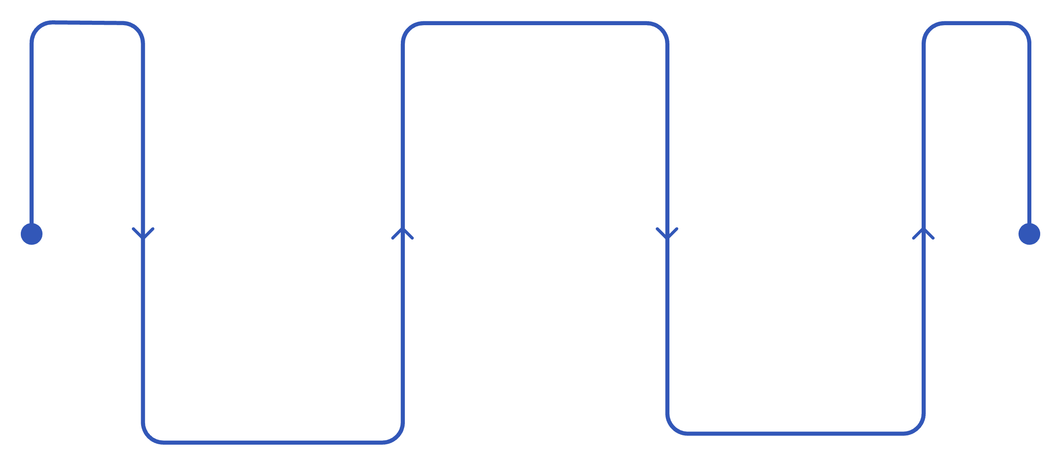


The Simple 3-Step Plan
The path to buying your first investment property or second home doesn't have to be complicated. David has helped buyers simplify this into three clear steps — and the order matters.
Build the Numbers
Estimate financing and cash needs
Have a Conversation
Shop With a Plan
Tell David what you're thinking
Agent and you know what to look for
Step 1 — Have a Conversation
Step 2 — Build the Numbers
Step 3 — Shop With a Plan
Tell David what you're thinking about doing. No commitment, no pressure. Just share your goals and let him help you understand what's realistic.
Review financing options, estimate the cash you'll need, and map out the full monthly picture so there are no surprises.
Now you and your real estate agent know exactly what you're looking for — and you're positioned to move with confidence when the right property appears.
Conversation → Numbers → Plan → Shop. Not the other way around.
DAVID STARLING | NMLS# 119565

Slide 15
Final Question
What would you say to the person who's been thinking about buying an investment property or second home for two or three years — but hasn't done anything yet?
"Stop trying to figure it all out by yourself. You don't have to be ready to buy tomorrow. Let's look at where you are, where you want to go, and whether buying an investment property or second home actually makes sense for you right now. The first step is just a conversation."
The people who build wealth through real estate aren't necessarily the ones who knew the most when they started. They're the ones who took the first step — and had the right team around them when they did. That conversation costs nothing. Waiting another two years might.
START THE CONVERSATION TODAY
DAVID STARLING | NMLS# 119565

Slide 16

Ready to Explore Your Options?
No pressure. No obligation. Just a straightforward conversation about what you're thinking and what might be possible. David Starling has helped buyers across the region navigate investment property and second home financing — and he's ready to help you too.
📞 Call or Text
(910) 620-3210
✉️ Email
david.starling@highlandmtg.com
🌐 Website
highlandmtg.com
📍 Office
4852 Randall Pkwy
Wilmington, NC 28405
No Pressure. Just a Plan.
David Starling | Producing Branch Manager | NMLS# 119565

Slide 17
Important Information
Financing options, qualification requirements, occupancy rules, rental income treatment, DSCR calculations, credit standards, down payment and reserve requirements vary by lender, investor, loan program, and borrower circumstances. Not all borrowers will qualify for all programs referenced in this presentation.
This presentation is for general educational purposes only and does not constitute a commitment to lend, a guarantee of loan approval, or financial, legal, or tax advice. All loan products are subject to credit approval, underwriting guidelines, and applicable regulations, which are subject to change without notice. Consult with a qualified financial or tax professional regarding your specific situation.
David Starling | Producing Branch Manager | NMLS# 119565
Highland Mortgage | 4852 Randall Pkwy, Wilmington, NC 28405
(910) 620-3210 | david.starling@highlandmtg.com | highlandmtg.com

