Slide 1

Reverse Mortgages Made Simple
What Every Homeowner 62+ Should Know
Hosted by Scott Hudspeth · Special Guest: Mark Hairston, Reverse Mortgage Specialist

Slide 2

Welcome
There's a lot of confusion — and a lot of fear — surrounding reverse mortgages. Today, we're here to cut through the noise. Whether you're a homeowner over 62 exploring your options, or an adult child helping a parent plan for retirement, this conversation is for you.
🎯 Separate Fact from Fiction
📚 Understand How It Works
Debunk the myths that keep people from exploring a legitimate financial tool.
Walk through the mechanics in plain, everyday language — no jargon.
✅ Make Informed Decisions
Leave with the knowledge to decide whether a reverse mortgage is right for your situation.

Slide 3
What Is a Reverse Mortgage?
"If someone has never heard of a reverse mortgage, how do you explain it?" — Scott Hudspeth
A reverse mortgage is a federally insured loan available to homeowners age 62 and older that allows you to convert a portion of your home equity into tax-free cash — without selling your home or making monthly mortgage payments.
Instead of you paying the lender each month, the lender pays you. The loan is repaid only when you sell the home, move out permanently, or pass away. You remain the owner of your home throughout the life of the loan.
The most common type is the Home Equity Conversion Mortgage (HECM), which is backed by the federal government and regulated by HUD and the FHA.
The Simple Version
You've spent decades building equity in your home. A reverse mortgage lets you access that equity as cash — on your terms — while you continue living in the home you love.

Slide 4



Who Is It Designed For?
Reverse mortgages aren't a last resort — they're a strategic retirement tool available to a wide range of homeowners.
Basic Qualifications
Property Requirements
Not Just for the Financially Struggling
You must be age 62 or older, own your home outright or have significant equity, and live in the home as your primary residence. Credit scores and income are not the primary qualifying factors.
Single-family homes, FHA-approved condos, and certain manufactured homes qualify. The property must meet HUD minimum standards, confirmed during the appraisal process.
Many of Mark's ideal clients are financially comfortable retirees who simply want to optimize their cash flow, reduce portfolio withdrawals, or fund healthcare and lifestyle goals without selling assets.

Slide 5

Biggest Misconceptions
These myths stop thousands of eligible homeowners from exploring a tool that could genuinely improve their retirement. Let's set the record straight.
❌ "The bank owns my home."
❌ "My kids can't inherit anything."
False. You retain full ownership and title to your home — just as you would with any other mortgage. The lender simply holds a lien, like any loan.
False. Heirs can inherit the home. They simply repay the loan balance — often by refinancing or selling — and keep any remaining equity.
❌ "I could be forced out of my home."
❌ "It's only for people who are broke."
False. As long as you live in the home, pay property taxes and insurance, and maintain the property, you cannot be forced to leave.
False. Many users are asset-rich retirees seeking smarter cash flow management. Financial advisors increasingly recommend reverse mortgages as a planning tool.

Slide 6





How Does the Money Work?
One of the most flexible features of a reverse mortgage is how you choose to receive your funds. There's no single required structure — you can tailor the payout to fit your lifestyle and financial goals.
Lump Sum
Monthly Income
Receive all available funds at once — ideal for paying off an existing mortgage, covering a large expense, or eliminating debt.
Receive fixed monthly payments for a set term or for as long as you live in the home — a reliable income supplement in retirement.
Line of Credit
Combination
Access funds only when you need them. Unused funds in the line of credit grow over time, making this the most popular and flexible option.
Mix and match — for example, a lump sum to pay off your current mortgage plus a line of credit for future needs. Completely customizable.
The line of credit growth feature is one of the most powerful and least understood aspects of a reverse mortgage — unused funds grow at the same rate as the loan's interest rate.

Slide 7
What Expenses Does It Eliminate?
The Big Win: No Monthly Mortgage Payment
What Obligations Remain?
For most homeowners, the mortgage is the single largest monthly expense. A reverse mortgage pays off any existing mortgage balance, and from that point forward, no monthly mortgage payment is required. This alone can free up hundreds or thousands of dollars every month — immediately improving cash flow in retirement.
A reverse mortgage is not a free pass from all housing costs. Borrowers must continue to:
Pay property taxes on time
Maintain homeowner's insurance
Keep the home in good repair
Continue living in it as your primary residence
Failing to meet these obligations can trigger default. Your specialist will walk you through a financial assessment to ensure long-term viability.

Slide 8




Who Should Consider One?
A reverse mortgage isn't for everyone — but for the right person, it can be a genuinely life-changing financial tool. Here are the situations where it tends to be the strongest fit.
Retirement Cash Flow
Healthcare Costs
Aging in Place
Financial Flexibility
Medical expenses often spike in later years. A reverse mortgage line of credit provides a tax-free reserve to cover in-home care, prescriptions, or unexpected procedures without liquidating other assets.
Many older Americans want to stay in their homes — close to family, neighbors, and community. Reverse mortgage funds can pay for accessibility modifications, making the home safer and more comfortable long-term.
Retirees with significant home equity but limited monthly income can use a reverse mortgage to bridge the gap — reducing reliance on Social Security or investment withdrawals.
A growing line of credit serves as a strategic buffer — a tax-efficient alternative to drawing down a 401(k) or IRA in a down market, preserving investment portfolios over time.

Slide 9




When Is It NOT a Good Fit?
Transparency matters. A reverse mortgage is a powerful tool — but it's not the right solution in every situation. Here's when to pause and explore other options first.
Planning to Move Soon
Limited Home Equity
Better Alternatives Available
If you anticipate relocating within 2–3 years, the upfront costs of a reverse mortgage (origination fees, closing costs) may outweigh the benefits. A shorter time horizon reduces the value of the loan.
The amount you can borrow is tied directly to your home's value, your age, and current interest rates. If your equity is minimal, the available funds may not be sufficient to meaningfully improve your financial picture.
In some cases, a traditional HELOC, downsizing, or family support may be a more cost-effective path. A good reverse mortgage specialist will always show you all your options — not just one.
A reputable specialist will tell you honestly if a reverse mortgage isn't your best option. That transparency is a sign of someone worth trusting.

Slide 10


Real Client Stories
Nothing builds confidence like hearing from real people in real situations. Here are a few examples of how a reverse mortgage changed the trajectory of someone's retirement — shared by Mark Hairston.
The Widow Who Stayed Home
The Couple Who Retired Early
The Son Who Called for His Mom
"After losing her husband, she was living on Social Security alone and worried about keeping up with expenses. A reverse mortgage eliminated her $900/month mortgage payment overnight. She's still in her home — the home she raised her children in — five years later."
"They had a strong 401(k) but didn't want to tap it during a market downturn. Using a reverse mortgage line of credit as a bridge, they avoided withdrawing at a loss and let their investments recover. Smart retirement planning — not desperation."
"An adult son reached out on behalf of his mother, who was resistant at first. After one conversation with Mark, she understood she'd retain ownership, her kids would still inherit equity, and she'd have peace of mind. She closed within 60 days."

Slide 11
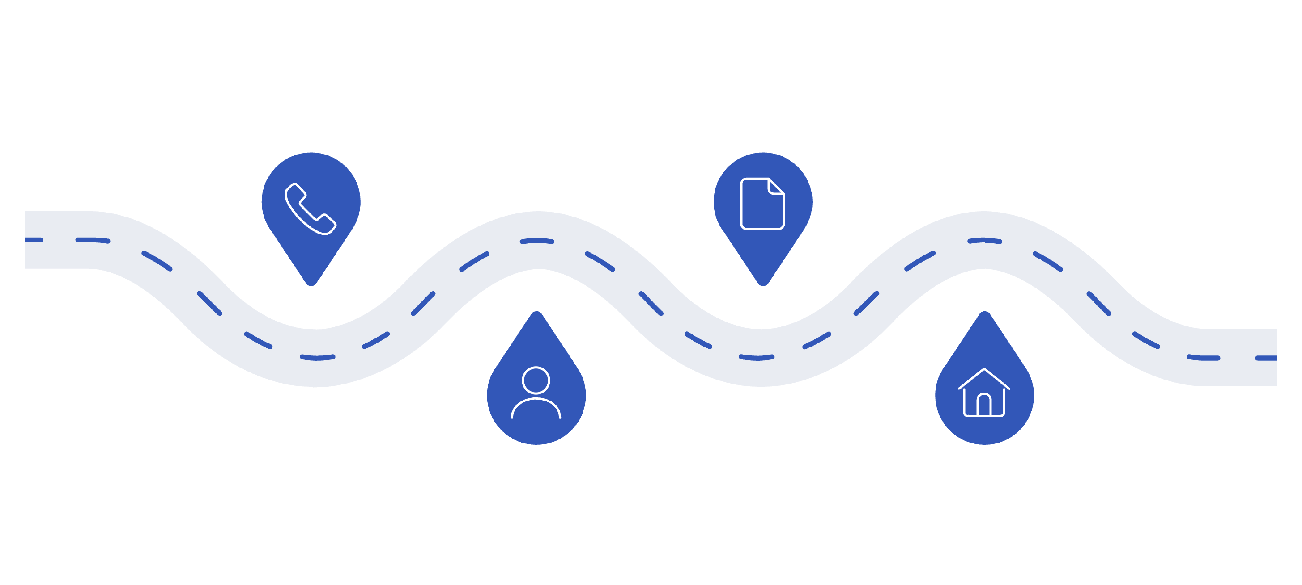
The Process: Step by Step
Getting a reverse mortgage is more straightforward than most people expect. Here's what the journey looks like from first conversation to closing day.
Consultation
Application
Review goals and eligibility
Submit paperwork and documents
HUD Counseling
Appraisal
Independent third-party session
FHA-certified home appraisal
The entire process typically takes 30–60 days from application to closing. The HUD counseling session — which is required by federal law — is an important consumer protection step, ensuring you fully understand the loan before committing. Most borrowers describe the overall experience as simpler than they anticipated.

Slide 12

Final Advice from Mark
"If viewers remember one thing, what should it be?" — Scott Hudspeth
Don't Let Fear Decide for You
Get the Facts First — Then Decide
Most of the hesitation around reverse mortgages comes from outdated myths and secondhand stories. The product has been significantly reformed over the past decade. Today's HECM is federally regulated, consumer-friendly, and built with protections that didn't exist 20 years ago.
You don't have to commit to anything in a consultation. Talk to a specialist, ask every question you have, and make a decision based on real information — not fear, not rumor, not what a neighbor said at a dinner party. Knowledge is the most powerful financial tool you have.

Slide 13
Questions & Next Steps
Ready to explore whether a reverse mortgage makes sense for your retirement? The best first step is a complimentary, no-obligation consultation with Mark Hairston — a conversation designed to answer your questions, not pressure you into anything.
Schedule Your Free Consultation
Contact Mark Hairston
In your personalized session, you'll get:
Reverse Mortgage Specialist
📞 Phone: [Add Phone Number]
📧 Email: [Add Email Address]
🌐 Website: [Add Website URL]
📍 Licensed in: [Add States]
A review of your eligibility and estimated loan amount
A side-by-side look at your payout options
Honest answers to every question you have
No pressure — ever
Hosted by Scott Hudspeth — Empowering homeowners to make confident, informed financial decisions.

