Slide 1

Short-Term Rental Financing in the Smokies
How to Buy, Finance & Think Like an Investor
Featuring Lisa Stepp | Hosted by Scotty Hudspeth
NMLS# 680403 | LISASTEPP.COM

Slide 2



Why the Smokies?
The Smoky Mountains aren't just a beautiful destination — they're one of the most consistently visited tourism regions in the United States. Investors keep coming back for good reason: multiple travel seasons, strong short-term rental demand, and a market where lifestyle and income potential converge in a rare and compelling way.
Year-Round Tourism
Three Distinct Markets
Lifestyle + Income
Fall foliage, winter getaways, spring hiking, and summer family vacations keep demand flowing across all four seasons.
Gatlinburg, Pigeon Forge, and Sevierville each draw different buyers and guests, offering varied price points and strategies.
Buyers from across the country are drawn by the dual promise of personal enjoyment and a property that may generate revenue.
"People aren't just buying a cabin. They're buying an experience that may also become an asset." — Scotty Hudspeth

Slide 3


Not Every Cabin Is a Good Investment
It's easy to fall in love with the view, the hot tub, and the game room. But emotion without analysis is how investors get into trouble. Before the cabin name, the décor theme, or the Instagram page — run the numbers on every one of these variables.
Purchase Price
Realistic Rental Projections
Property Taxes & Insurance
Does the asking price support a realistic return at current financing rates?
Not best-case — realistic, comparable, and data-supported estimates for your specific property.
STR insurance is a specialty product. Don't assume your standard homeowner's policy will cover commercial rental activity.
HOA / Road Maintenance
Management, Repairs & Reserves
Some communities charge significant fees that directly impact your bottom line.
Property management, utilities, cleaning, turnover costs, and a reserve fund for the unexpected all need to be accounted for.
A beautiful cabin can still be a bad investment. Run the numbers first — every time.

Slide 4
Gatlinburg, Pigeon Forge, or Sevierville?
Each area within the Smokies has its own character, guest profile, and investment dynamic. Understanding the differences helps you match the right property to the right strategy — before you ever make an offer.
🏔 Gatlinburg
🎡 Pigeon Forge
🏡 Sevierville & Surrounding Areas
Direct access to Great Smoky Mountains National Park — the most-visited national park in the country. Strong vacation identity, premium positioning, and loyal repeat visitors make this a high-demand market.
Attractions, entertainment venues, and family-friendly travel define this corridor. High foot traffic and broad appeal support strong short-term rental activity throughout the year.
A broader mix of property types with varied price points. Often a more accessible entry point for investors seeking value with strong proximity to the major draw areas.
"There is no universal 'best area.' The right market depends on the property, strategy, and numbers." — Scotty Hudspeth

Slide 5
The 5 Numbers Every STR Buyer Needs
Before you tour cabins, name your rental, or design a logo — there are five numbers your lender needs to have a productive conversation with you. These numbers are the foundation of every financing plan.
1
2
3
Purchase Price
Cash Available
Monthly Payment Est.
What are you actually paying? This anchors every other calculation in the plan.
Down payment, closing costs, and reserves — all three matter from day one.
Principal, interest, taxes, insurance — the full picture of what you'll owe monthly.
4
5
Realistic Rental Income
Reserves After Closing
Not the listing's best month. A realistic, comparable projection you can defend.
What's left in the bank when the deal closes? This matters more than most buyers realize.
"Five numbers. Before the cabin name. Before the logo. Before the Instagram page." — Scotty Hudspeth

Slide 6

Cash Flow Is More Than Rent Minus Mortgage
One of the most common misconceptions in short-term rental investing: assuming that gross rental income minus the mortgage equals profit. The real picture is more nuanced — and knowing it upfront protects your investment.
The Oversimplified Math
What's Often Left Out
Gross Rental Income: $80,000
Mortgage Payment: $50,000
Assumed Profit: $30,000
This calculation is dangerously incomplete.
Property taxes and insurance
Property management fees (often 20–30%)
Utilities and internet
Cleaning and turnover costs
Repairs and ongoing maintenance
Furnishings and replacements
HOA and road maintenance fees
Vacancy and seasonal downtime
Gross revenue is not profit. Know the real picture — every line item — before you commit to a purchase.

Slide 7

How Do You Finance a Short-Term Rental?
This is the question investors search for at midnight. The answer depends on how you plan to use the property, your financial profile, and which loan program best fits your situation. There is no single path — and that's actually good news.
Conventional Investment Property Financing
A standard approach for properties classified as investment properties. Typically requires higher down payments and reserves than primary residence loans.
Second-Home Financing
Available when occupancy intent, property characteristics, and program guidelines are genuinely met. Different qualification standards apply.
DSCR Financing
Debt Service Coverage Ratio loans qualify based heavily on the property's projected rental income rather than your personal income documents.
Non-QM / Bank Statement Options
Useful for self-employed buyers or those with income structures that don't fit traditional documentation requirements.
Equity Strategies
Leveraging existing property equity — through refinancing or other tools — as part of the funding plan for a new acquisition.
Key principle: The financing structure should match how you actually plan to use the property — and that conversation starts before you go under contract.

Slide 8
DSCR: The Property Helps Tell the Story
DSCR stands for Debt Service Coverage Ratio. It's a loan structure designed specifically for investment properties — and it's changed the game for many STR buyers, especially those who are self-employed or building a portfolio.
How DSCR Works
What Still Matters
Instead of primarily evaluating your personal income, certain investor loan programs focus on the relationship between the property's qualifying rental cash flow and its debt obligation. If the property can service the debt, that becomes a central part of the story.
DSCR is not a free pass. Lenders will still evaluate:
Credit profile and history
Down payment and loan-to-value ratio
Cash reserves after closing
Property eligibility and condition
Designed specifically for investment properties
Personal income documents may not be the primary qualifying method
Valuable for self-employed buyers and portfolio investors
"Instead of only asking what you make — we're also looking at what the property may produce."

Slide 9
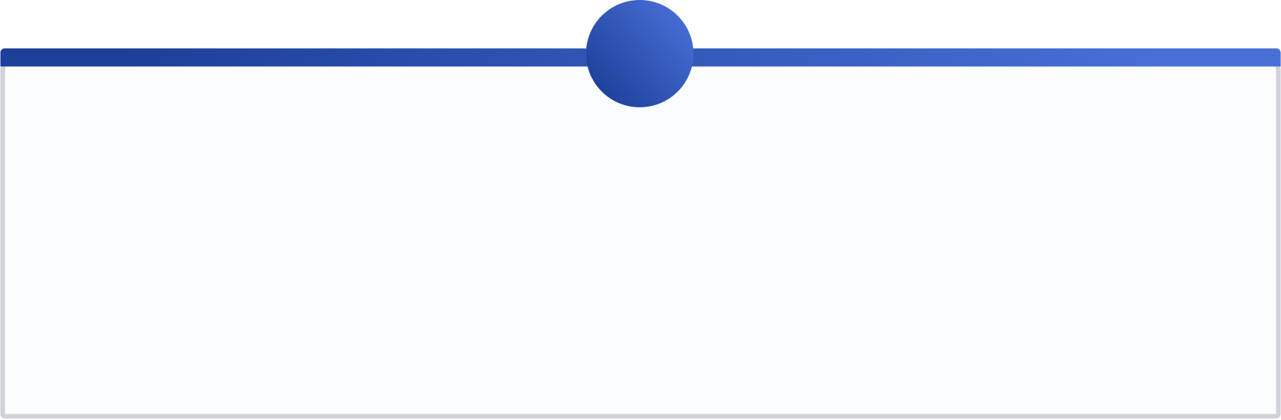
AirDNA & Rental Projections
Market data tools like AirDNA have become a staple of the STR investor's research process. But how that data is used in a financing conversation is something every buyer needs to understand before they build their entire plan around a screenshot.
1
2
Some Programs Accept STR Market Data
AirDNA Frames Potential Revenue
Certain investor loan programs may consider approved short-term rental market analysis as part of the income picture — but this varies significantly by lender and program.
These tools provide useful market-level context and comparable property performance data. They can inform a projection — but they are not the projection itself.
3
4
Guidelines Determine Acceptability
A Projection Is Not a Guarantee
What a lender or investor will accept as qualifying rental analysis is governed by their specific guidelines. Not all data sources are treated equally across programs.
Rental projections represent estimated potential — not a commitment of future income. Seasonality, vacancy, and market shifts all affect actual performance.
"Don't build your entire dream around a screenshot. Let Lisa review the financing and the data together." — Scotty Hudspeth

Slide 10
Second Home or Investment Property?
This is one of the most consequential — and most misunderstood — questions in STR financing. The answer affects your down payment requirement, your interest rate, your loan program, and your qualification approach. And it's not a choice you make for better terms; it's a reflection of your actual plan.
Second Home
Investment Property
Occupancy intent, loan program eligibility, property characteristics, and actual use patterns must genuinely support this classification. Lower down payment requirements may apply when truly eligible.
If your primary purpose is rental income and portfolio growth — with limited personal use — this is the accurate classification. Higher down payment and reserves are typically required.
The factors that determine which category applies include: your occupancy intent, rental plans, the property's characteristics, and the specific program requirements of the loan you're pursuing. The truthful intended use of the property drives the conversation — not the outcome you'd prefer.
You don't pick the box that gives you the best deal. You explain the plan honestly — and let the loan structure follow the facts.

Slide 11
The Biggest Mistakes STR Buyers Make
These aren't edge cases. These are patterns that repeat constantly in the STR financing world. Knowing them in advance puts you ahead of the majority of buyers entering this market.
1
Shopping Before Understanding Financing
Falling in love with a property before knowing what you can qualify for — or at what terms — is a recipe for disappointment.
2
Overestimating Rental Income
Using best-case projections rather than realistic, comparable market data leads to a plan that can't sustain itself.
3
Underestimating Expenses
Management fees, insurance, maintenance, utilities, and reserves are real costs that must be built into every cash flow analysis.
4
Spending Every Dollar at Closing
Arriving at closing with no reserves leaves zero margin for the inevitable — a slow season, a broken HVAC, or an unexpected repair.
5
Waiting Until Under Contract to Call the Lender
This is the most preventable mistake of all. The financing conversation should happen before the property search — not after an accepted offer.
"Number eight is why we're recording this." — Scotty Hudspeth

Slide 12
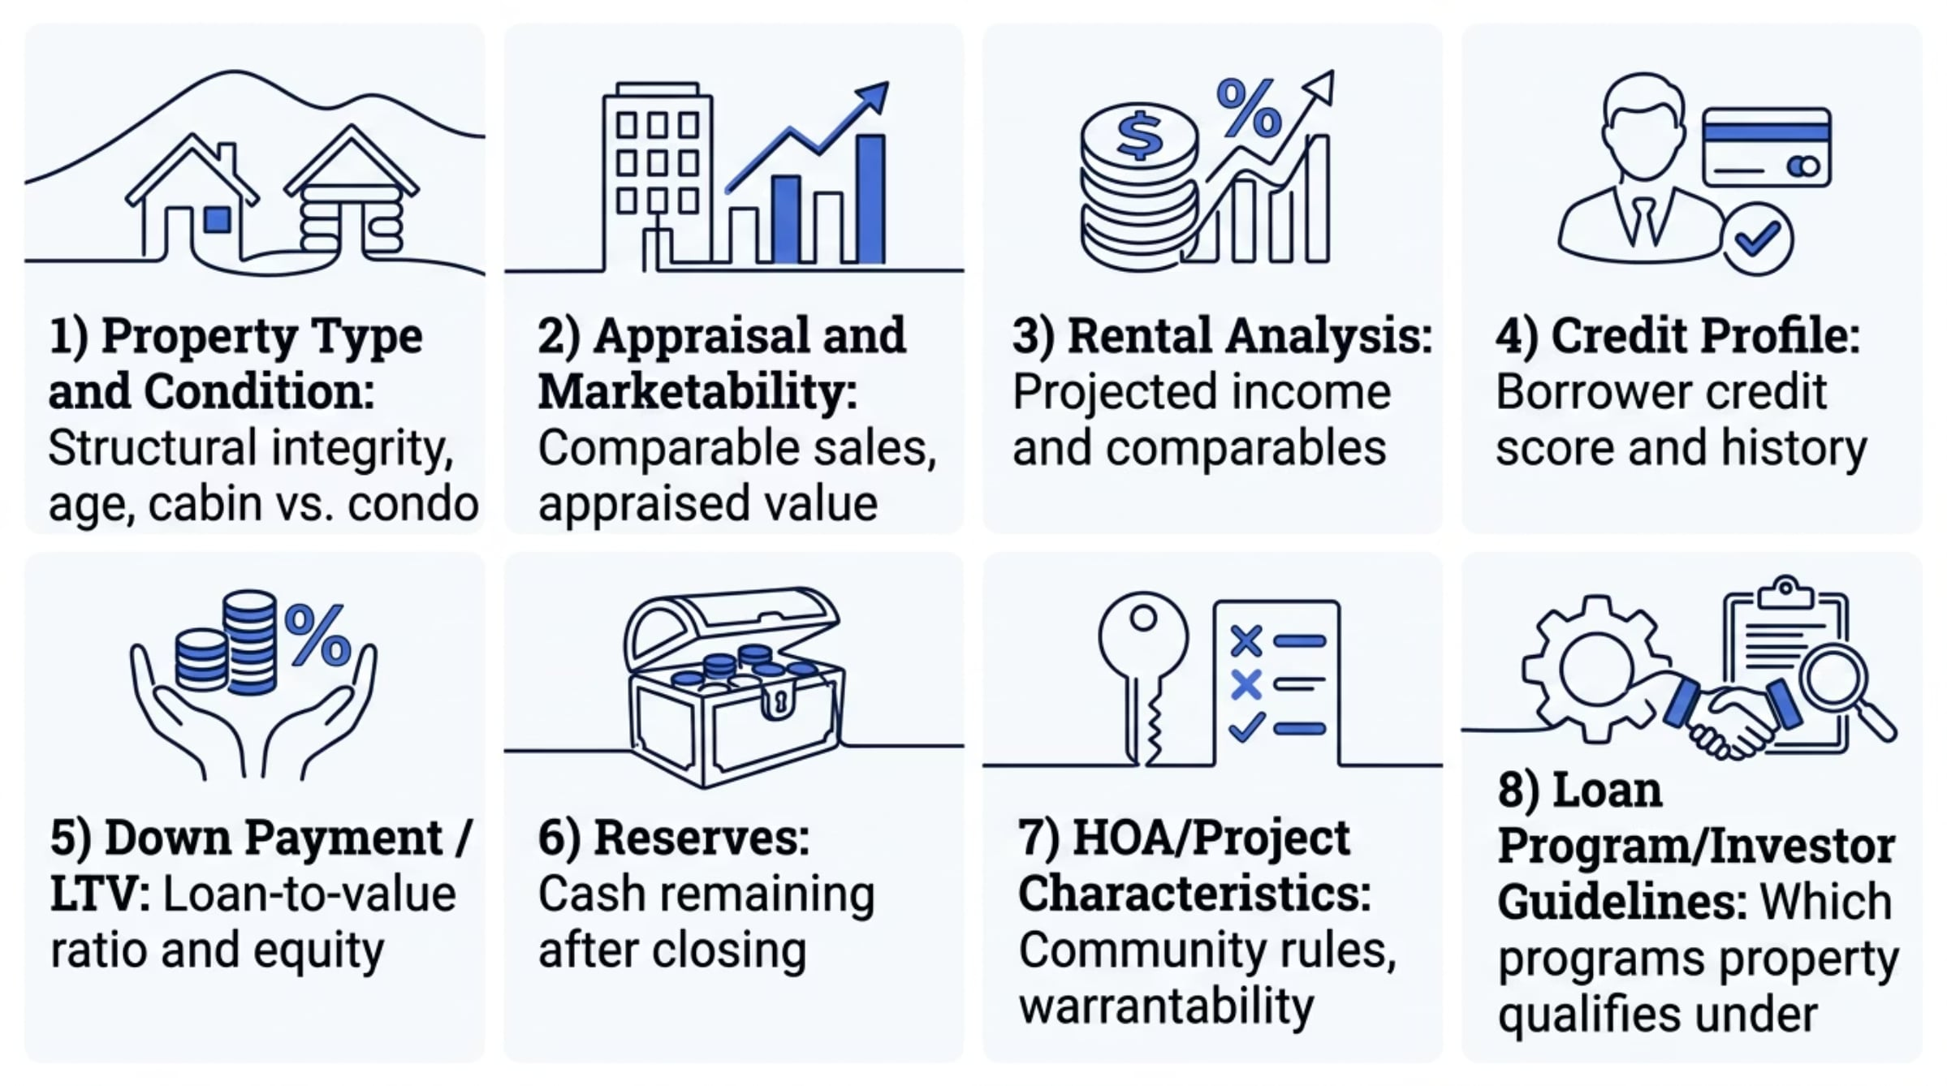
What Makes an STR Deal Financeable?
Two cabins can look nearly identical online — same price range, same amenities, same mountain views. But their financing picture can be completely different. Here's why every deal needs to be evaluated on its own terms.
"The property matters. The borrower matters. The program matters. That's exactly why you need a specialist." — Scotty Hudspeth

Slide 13

The Simple 3-Step STR Plan
Whether you're watching from Ohio, Florida, New York, or anywhere else — this is the framework that turns a cabin dream into a fundable, actionable investment plan. Three steps. In order. Every time.
Build Financing
Cash, payment plan, realistic numbers
Tell the Goal
Shop with Team
Personal use, income, or growth?
Realtor and buyer aligned on criteria
Step 1 — Tell Me the Goal
Step 2 — Build the Financing Plan
Step 3 — Shop with the Right Team
Personal use? Rental income? Long-term portfolio growth? Your goal shapes every decision that follows — especially the financing structure.
Cash available, estimated payment, loan program, and a realistic income picture. This is the foundation your entire purchase strategy is built on.
Now your Realtor and you know exactly what you're looking for, what you can qualify for, and what makes a property worth pursuing.
"Goal. Financing. Team. Then go cabin shopping." — Scotty Hudspeth

Slide 14

Final Question: What Are You Waiting For?
For anyone who has been watching cabins online for two years — browsing Airbnb listings, running imaginary numbers, and wondering "what if" — Lisa has a message.
"You don't have to have everything figured out before we talk. Tell me what you're thinking about buying, how you hope to use it, and what your goals are. We'll look at the financing, the numbers, and the options together. The first step is simply a conversation."
— Lisa Stepp, NMLS# 680403
You Don't Need a Perfect Plan
The Window Is Open — For Now
You just need a starting point. A 15-minute conversation with a specialist is worth more than two years of late-night Airbnb browsing.
Markets shift. Rates change. Inventory moves. The buyers who act with a clear plan are the ones who find the right property at the right terms.
Stop scrolling cabins at midnight. The first step is a conversation — not a commitment.

Slide 15

Ready to Explore a Smoky Mountain Short-Term Rental?
Lisa Stepp-Seritt
Mpire Financial Group LLC
Mortgage Specialist | Mpire Financial
NMLS# 680403
Company NMLS# 2108504
189 S Orange Ave, Suite 2030
Orlando, FL 32801
Company: 407-287-6550
www.mpirefi.com
📱 Mobile: 518-894-0517
📞 Office: 865-352-8222
✉️ lisa@steppupyourgame.com
🌐 LisaStepp.com
Whether you're just starting to explore or ready to move forward — the first step is a conversation. Lisa specializes in helping investors navigate the unique financing landscape of Smoky Mountain short-term rentals.

Slide 16

Important Information
This presentation is for general educational purposes only and is not a commitment to lend, a guarantee of loan approval, or investment, tax, or legal advice.
Financing options, qualification requirements, occupancy rules, rental income treatment, short-term rental data usage, DSCR calculations, credit standards, down payment, reserve requirements, and property eligibility vary by lender, investor, loan program, and individual borrower circumstances.
Rental projections and market data are estimates only and are not guarantees of future income, occupancy, or investment performance. Past performance of comparable properties does not guarantee future results for any specific property.
All loan programs referenced are subject to change without notice. Not all applicants will qualify. Loan approval is subject to underwriting guidelines and is not guaranteed based on pre-qualification or pre-approval.
Lisa Stepp | NMLS# 680403 | Mpire Financial Group LLC | Company NMLS# 2108504
189 S Orange Ave, Suite 2030, Orlando, FL 32801 | LisaStepp.com | mpirefi.com

